Slide 1

Chapter 6 Methods to initiate ventures

Slide 2
Effective way to approach a new business venture
1st approach (to create a unique product or service) one that is not being offered today but would be in great demand if it were.
2nd approach (adapt something that is currently on the market or extend the offering into an area in which it is not presently available.
Part of project (which one you are following for your project)

Slide 3


1st approach / 2nd approach

Slide 4


Window of opportunity is there
(only then 2nd approach is possible)
1st approach / 2nd approach

Slide 5
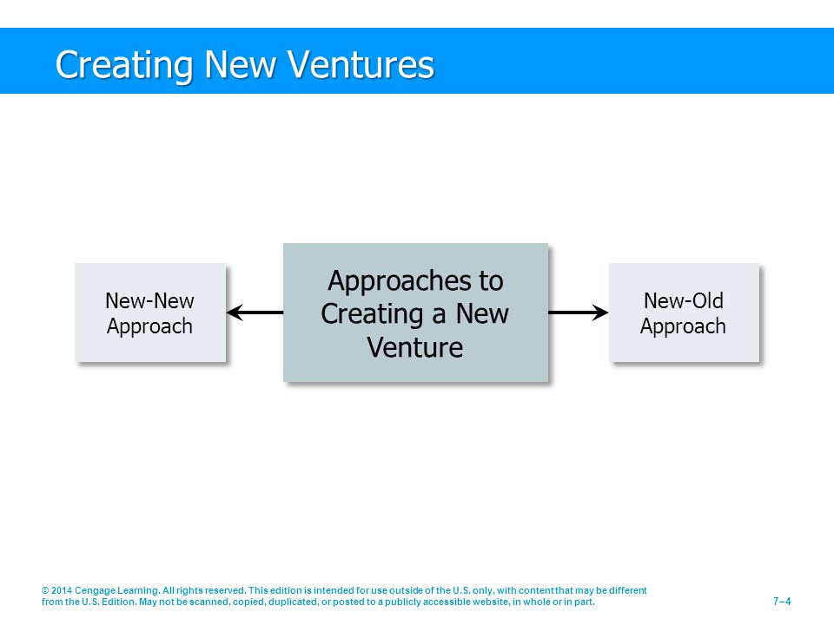

Slide 6
NEW – NEW Approach
Smartphones.
MP3 players.
Plasma television.
Global positioning systems (GPS)

Slide 7
New Old Approach
Not start with a totally unique product.
Someone else’s idea by :
Improving a product or offering services in an area in which it is not currently available (New Old Approach).
This approach is risky because competitors can move in easily.

Slide 8


New Old Approach

Slide 9
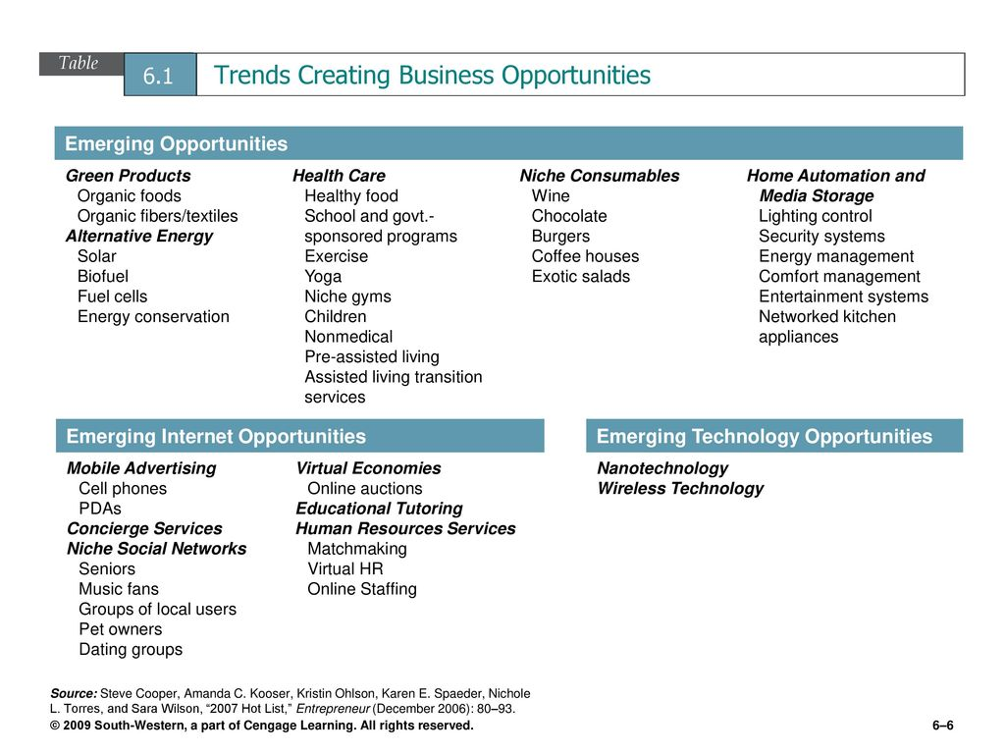

Slide 10
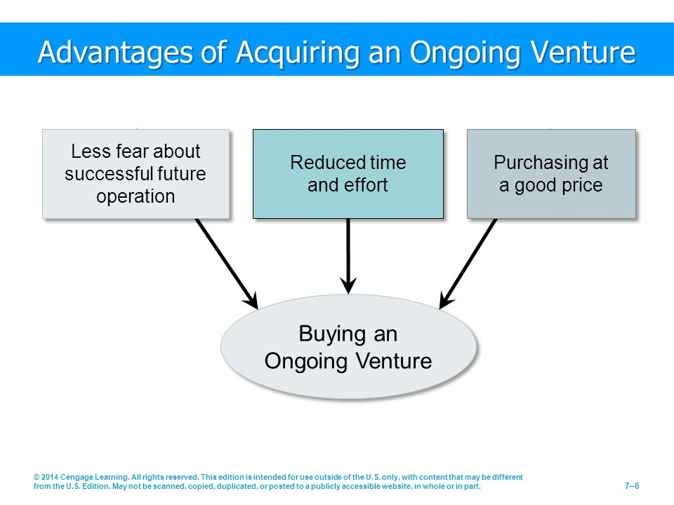

Slide 11
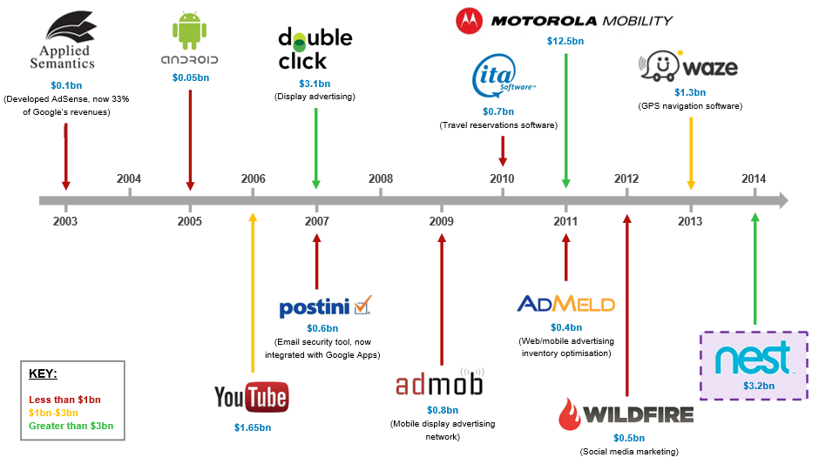
Buying an on going venture

Slide 12
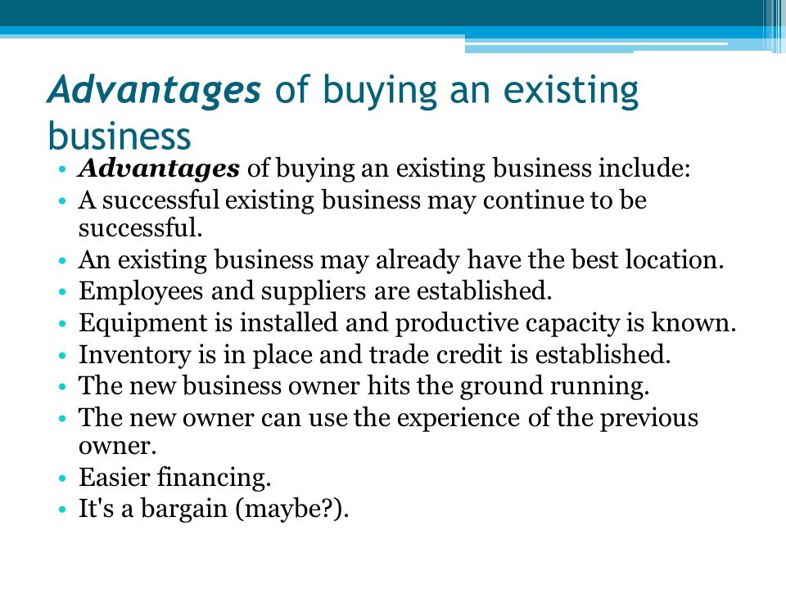

Slide 13
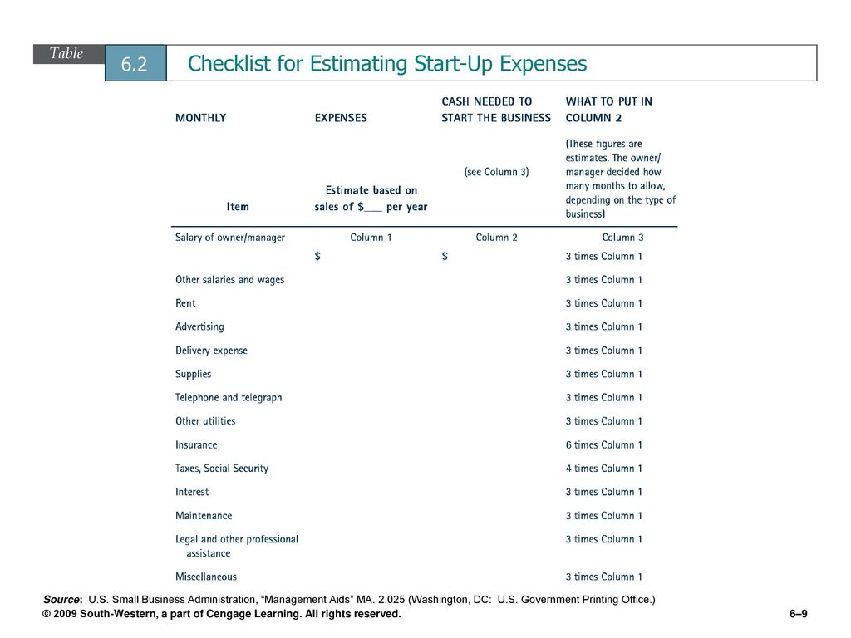

Slide 14
Acquiring an established entrepreneurial venture- then take these steps
Personal preferences.
Examination of opportunities.
Advantages of acquiring an ongoing venture.
Reduced time and effort.
A good price.
Evaluation of the selected venture.
The business environment.
Profits, sales and operating ratios.’
The business assets (inventory, other assets, accounts receivable, trademarks, patents, copyrights.
Goodwill.
Key questions to ask
What is the business being sold?
What is the current physical condition of the business?
What is the condition of the inventory?
What is the state of the company’s other assets?
How many of the employees will remain?
What type of competition does the business face?
What does the firm’s financial picture look like?

Slide 15
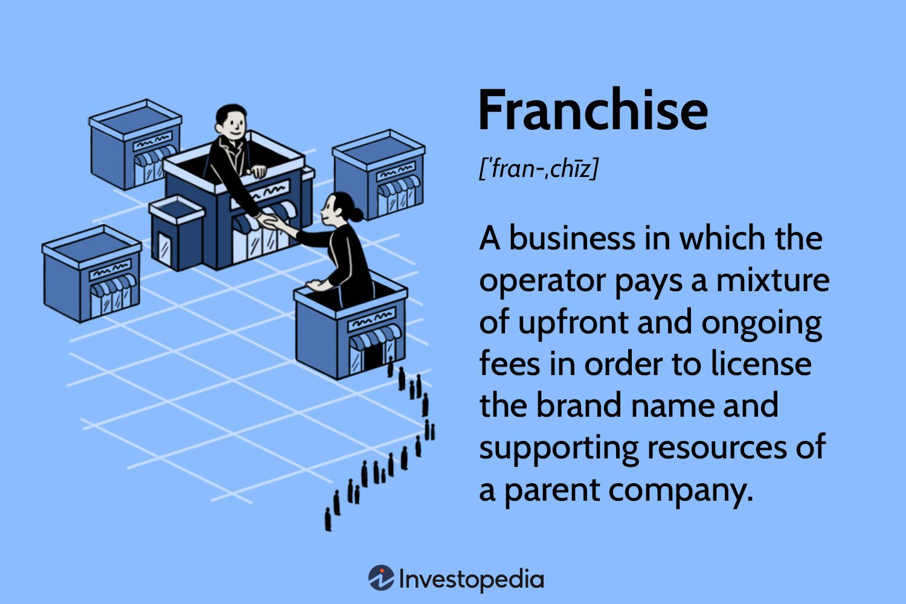

Slide 16


Slide 17
How a Franchise Works? What franchisee is giving to franchisor?
Make a financial investment in the operation.
Obtain and maintain a standardized inventory and / or equipment package usually purchased from the franchisor.
Maintain a specified quality of performance.
Follow a franchise fee as well as a percentage of the gross revenues.
Engage in a continuing business relationship.

Slide 18
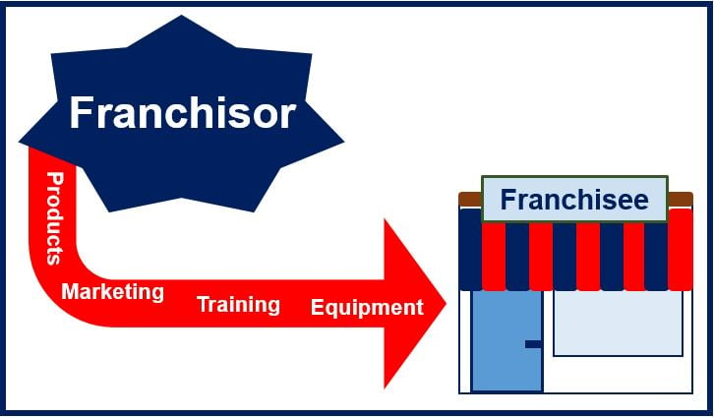
Franchisor VS Franchisee / How a Franchise Works? What franchisee is giving to franchisor?

Slide 19
Disadvantages of Franchising
Franchise Fees.
Franchisor Control.
Unfulfilled promises.
Franchise law.
Evaluating the opportunities.
Learn of opportunities.
Investigate the franchisor.

Slide 20
What do you think?
Will you expand your business by Franchising? Yes / No Why?
Will you go into business by buying franchise? Yes / No Why?

Slide 21


